Slide 1
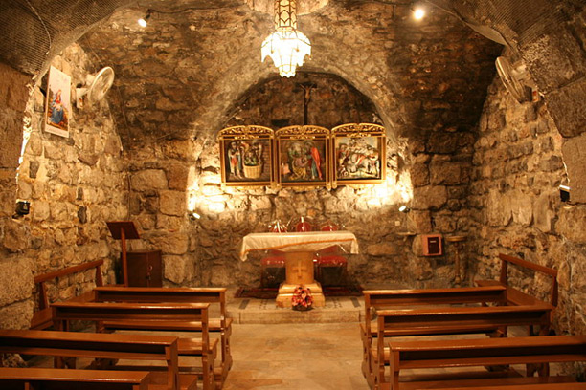
ASIAN CHURCH HISTORY
Chapel of St. Ananias, Damascus, Syria
Steve Nicholes, Word of Life Bible Institute, Jeju Island, Korea • Available at BibleStudyDownloads.org

Slide 2
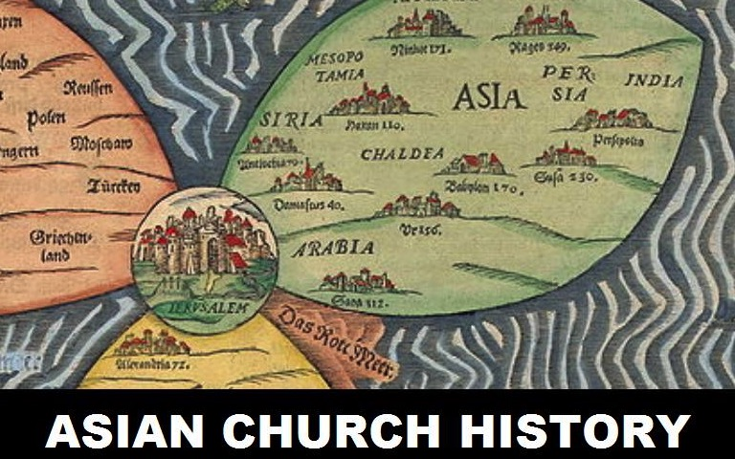

Slide 3
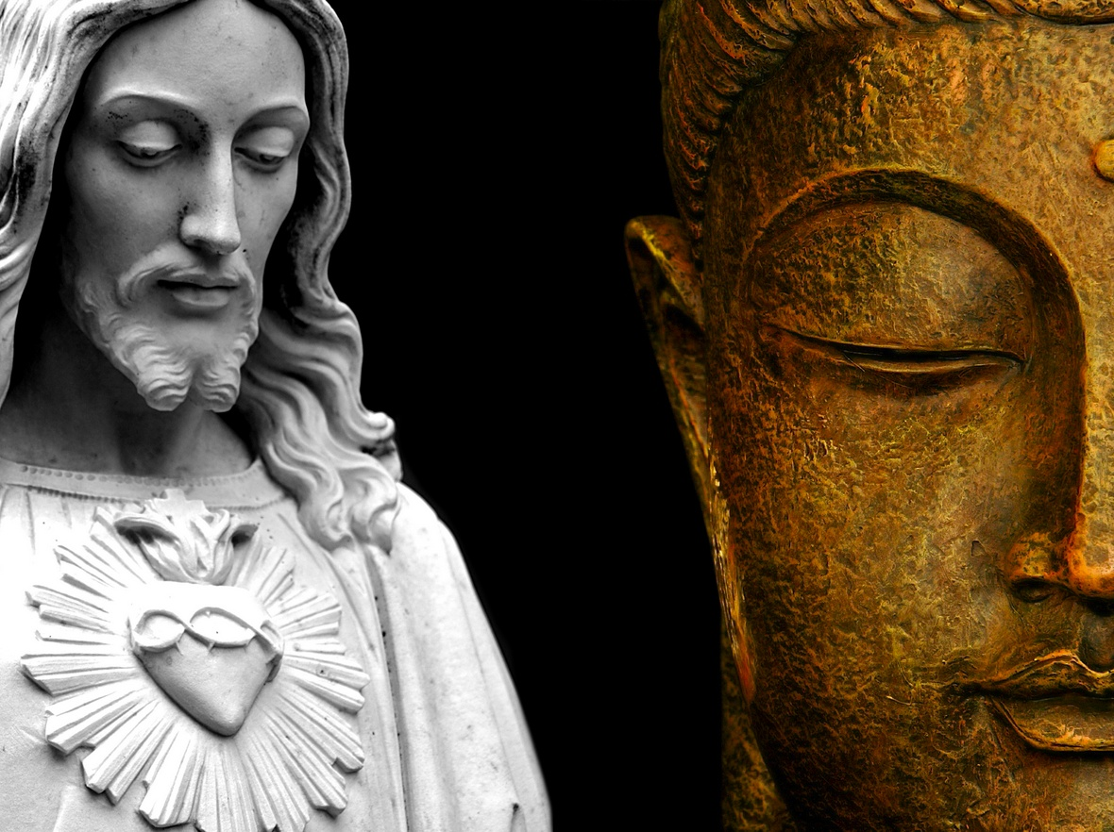
ASIA'S MESSAGE TO EUROPE
“Is not Asia the birth place of great prophets and saints? Is it not preeminently a holy place of pilgrimage to the rest of the world? Yes upon Asia’s soil have flourished and prospered those at whose feet the world should prostrate. The great religions which have given life and salvation to millions of men owe their origin in Asia.”
Message from Brahma leader from Bengal Keshub Chandra Sen

Slide 4
ASIA'S MESSAGE TO EUROPE
“But Asia is not only holy ground…
In this one place you could count all leading prophets and all the great religious geniuses of the world. No great prophet was born outside the boundary of Asia.”
Message from Brahma leader from Bengal Keshub Chandra Sen

Slide 5
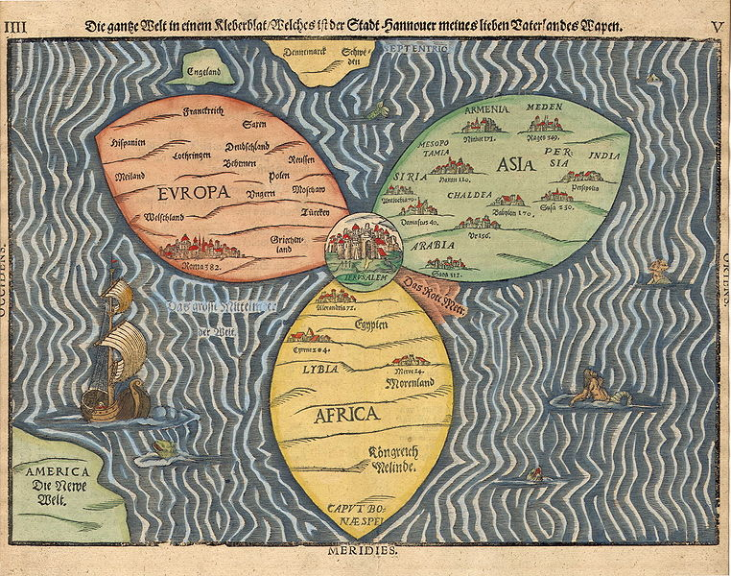
BACK TO JERUSALEM

Slide 6
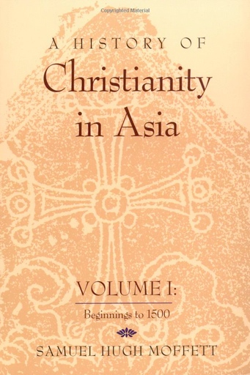
Israel is a part of western Asia
A History of Christianity in Asia by Samuel Hugh Moffett

Slide 7
Israel is a part of western Asia
“In earliest history, the first Christian centers, Jerusalem, Antioch & Ephesus were in Asia. The first known church building was in Asia, the first NT translation was in Asia. The first Christian king; the first Christian poets; the first Christian state were all in Asia.”
A History of Christianity in Asia by Samuel Hugh Moffett

Slide 8
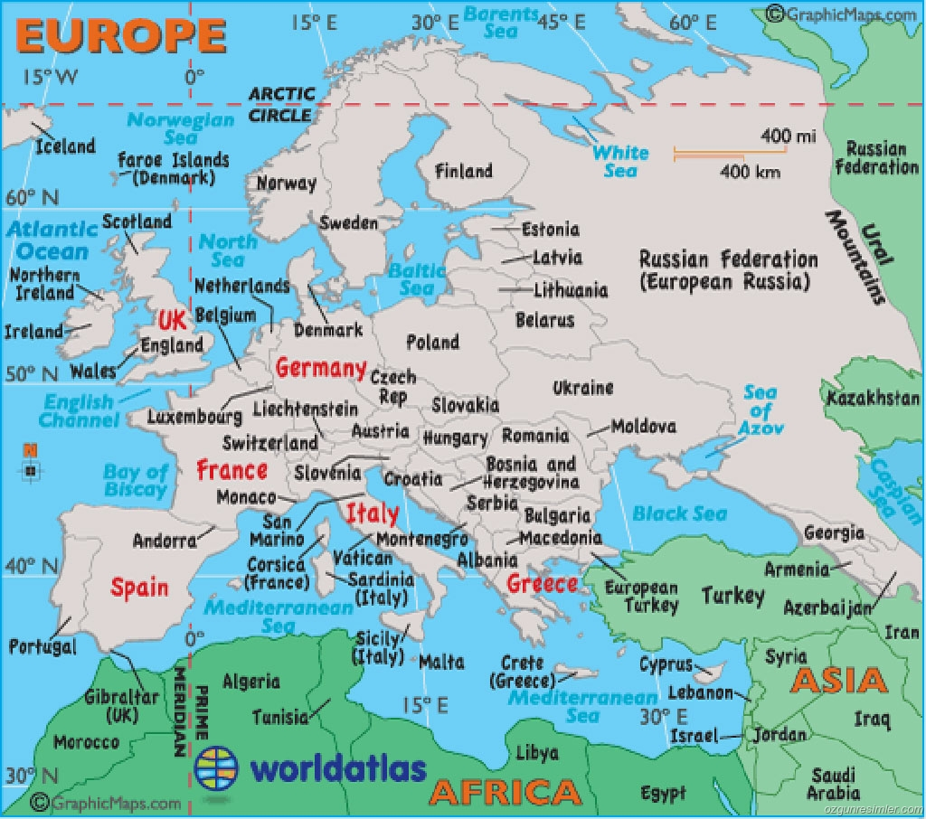
THE CHURCH OF THE EAST
The “Church of the East” is not in Eastern Europe but east of Europe in Asia

Slide 9
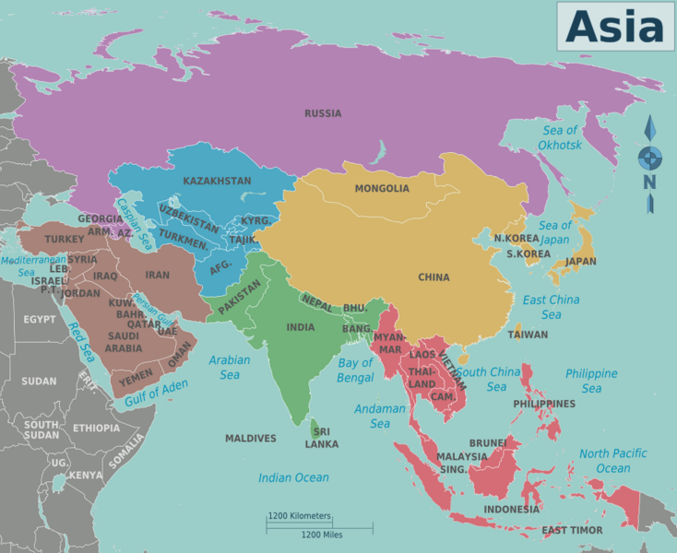
REGIONS OF ASIA
CENTRAL ASIA
EAST ASIA
WEST ASIA
SOUTH ASIA
SE ASIA

Slide 10
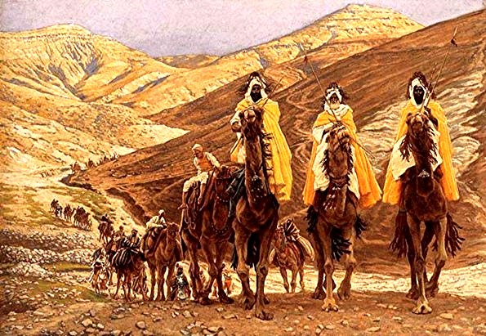
THE MAGI
The tradition from the Assyrians is the 12 magi (listed by name and with the name of their fathers) came from the modern city of Edessa to Bethlehem to see Jesus. When they returned to Syria they brought the story of Jesus with them.
James Tissot – Journey of the Magi (1894)

Slide 11
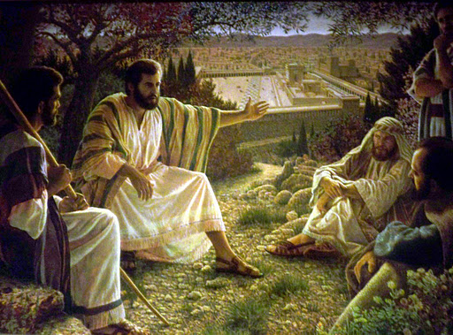
ASIAN CHURCH HISTORY
“Go into all the world and preach the gospel to every creature.”
Mark 16:15
Mt of Olives

Slide 12
ASIAN CHURCH HISTORY
“But you shall receive power when the Holy Spirit has come upon you; and you shall be witnesses to Me in Jerusalem, and in all Judea and Samaria, and to the end of the earth.”
Acts 1:8
Mt of Olives

Slide 13
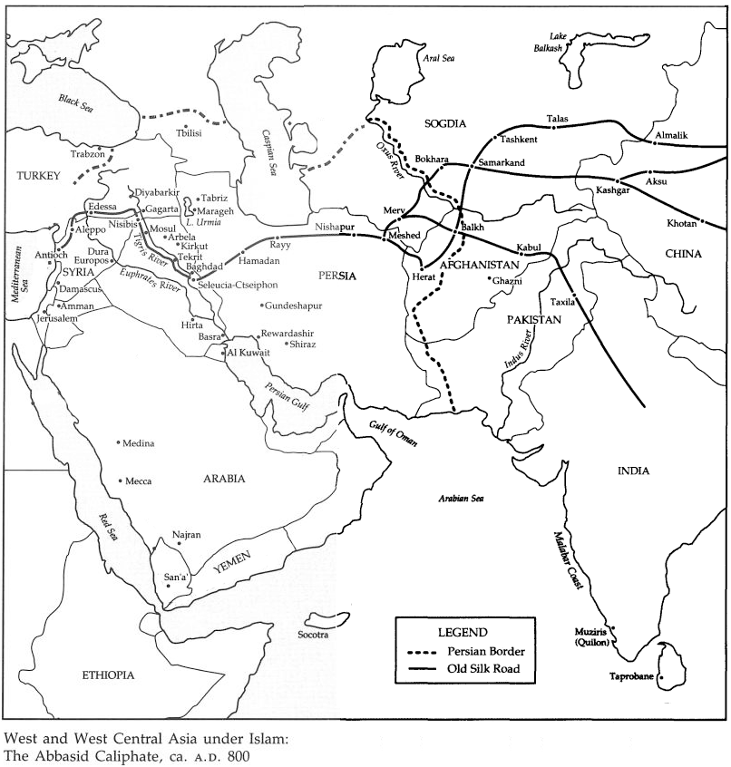
ASIAN CHURCH HISTORY
PARTHIA
MEDIA
ELAM

Slide 14
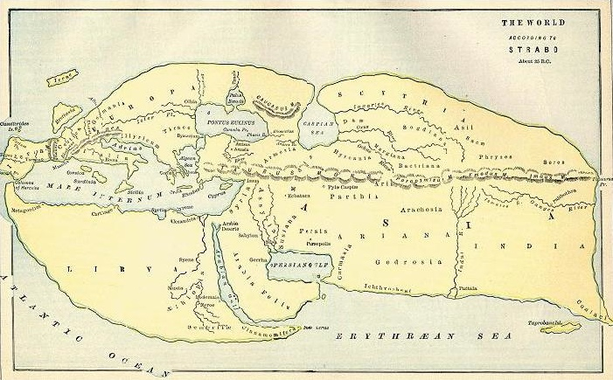
The known world of the first century was mainly western Asia, northern Africa and southern Europe.
Strabo’s Map of the World (20-25 AD)

Slide 15
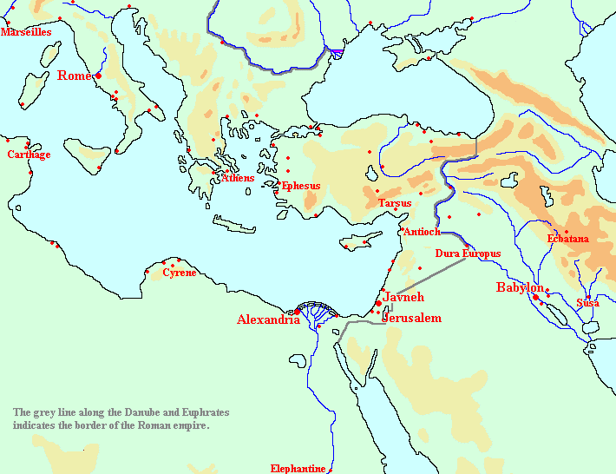
JEWS IN THE EAST
In the first century the number of Jews living in the Persian world, mostly in or near Babylon, may have been 1 million people.

Slide 16
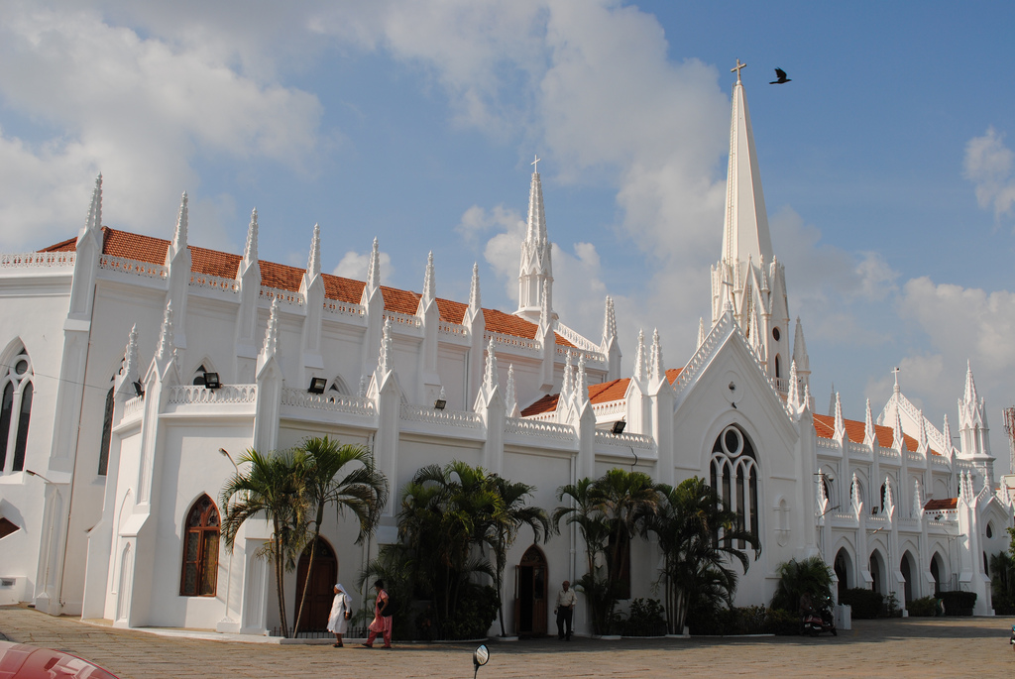
One of the oldest and strongest traditions is that in AD 52 (between Paul’s second and third missionary journeys) the apostle Thomas took the gospel to India and even China.
St Thomas Bascilica, Madras, India

Slide 17
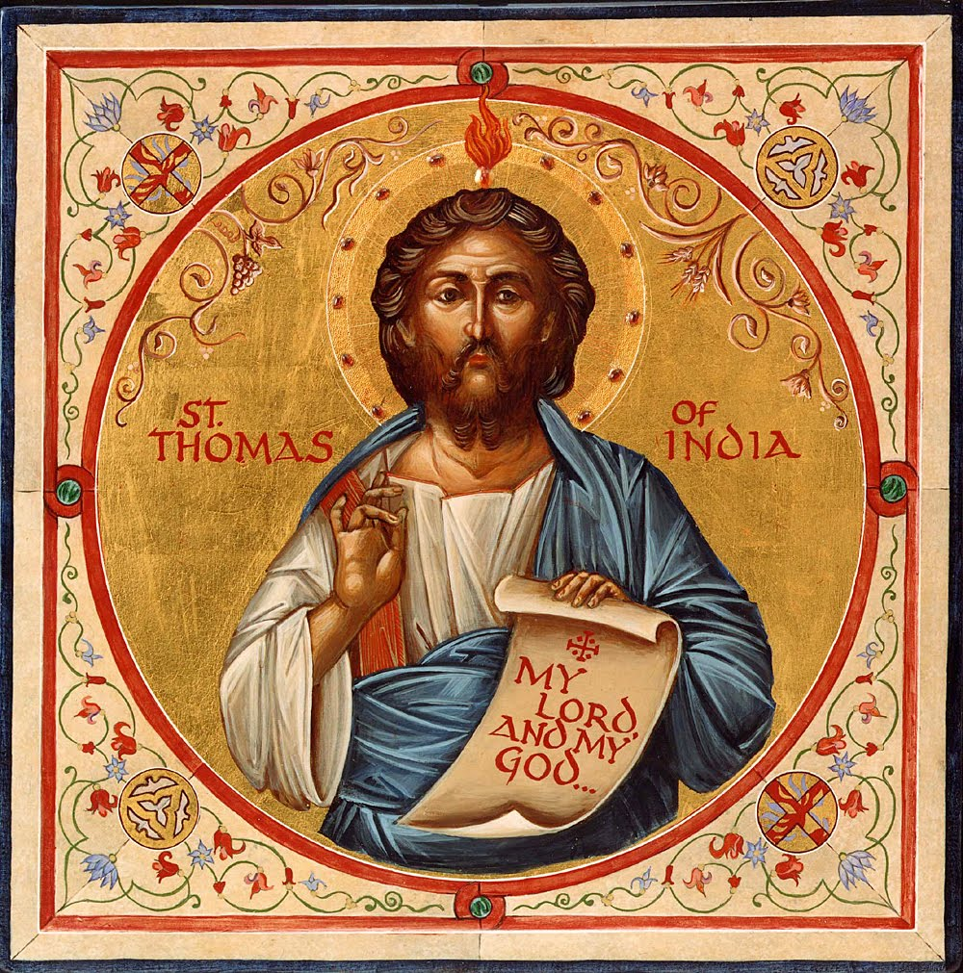
ACTS OF THOMAS

Slide 18
“1. At that season all we the apostles were at Jerusalem … and we divided the regions of the world, that every one of us should go unto the region that fell to him and unto the nation whereunto the Lord sent him.”

Slide 19
“According to the lot, therefore, India fell unto Judas Thomas, which is also the twin: but he would not go, saying that by reason of the weakness of the flesh he could not travel, and 'I am an Hebrew man; how can I go amongst the Indians and preach the truth?’”

Slide 20
“And as he thus reasoned and spoke, the Savior appeared unto him by night and said to him: Fear not, Thomas, go thou unto India and preach the word there, for my grace is with thee.”

Slide 21
“But he would not obey, saying: Wherever you desire, send me, but somewhere else, for unto the Indians I will not go.”

Slide 22
“2 And while he thus spoke and thought, it chanced that there was there a certain merchant come from India whose name was Abbanes, sent from the King Gundaphorus.”

Slide 23
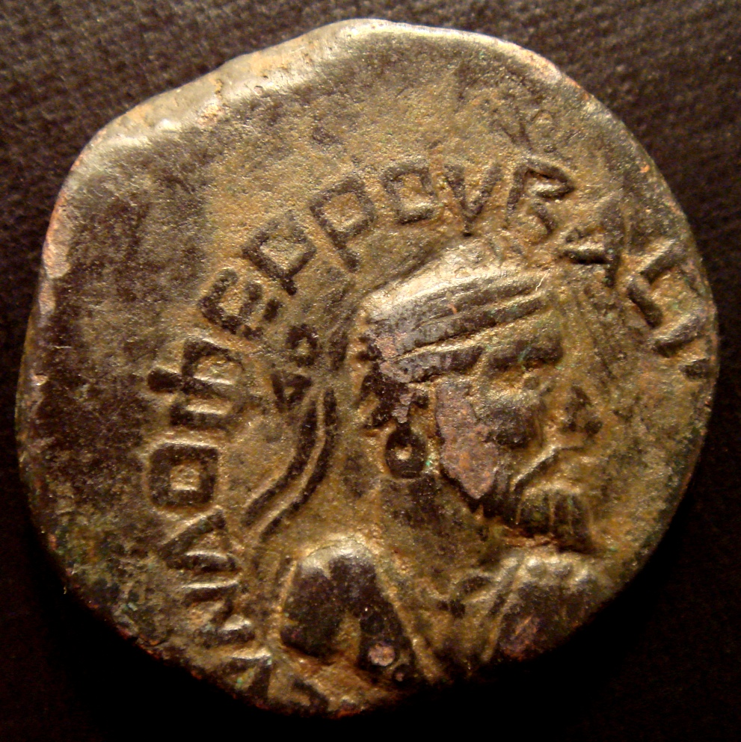

Slide 24
“2 There a certain merchant come from India whose name was Abbanes, sent from the King Gundaphorus, and having commandment from him to buy a carpenter and bring him unto him.”

Slide 25
“Now the Lord seeing him walking in the market-place at noon said unto him: Would you desire to buy a carpenter? And he said to him: Yea. And the Lord said to him: I have a slave that is a carpenter and I desire to sell him.”

Slide 26
“And so saying he showed him Thomas afar off, and agreed with him for three litrae of silver unstamped, and wrote a deed of sale, saying:”

Slide 27
“I, Jesus, the son of Joseph the carpenter, acknowledge that I have sold my slave, Judas by name, unto you Abbanes, a merchant of Gundaphorus, king of the Indians.”

Slide 28
“And when the deed was finished, the Savior took Judas Thomas and led him away to Abbanes the merchant, and when Abbanes saw him he said unto him: Is this your master? And the apostle said: Yes, he is my Lord.”

Slide 29
“And he said: I have bought you from him. And the apostle held his peace.”

Slide 30
“3. And on the day following the apostle arose early, and having prayed and besought the Lord he said: I will go wherever You desire, Lord Jesus: Your will be done. And he departed unto Abbanes the merchant, taking with him nothing at all except only his price.”

Slide 31
“For the Lord had given it to him, saying: Let your price also be with your, together with my grace, wherever you go. And the apostle found Abbanes carrying his bags on board the ship; so he also began to carry it aboard with him.”

Slide 32
“And when they were on the ship and were set down Abbanes questioned the apostle, saying: What craftsmanship do you know? And he said: In wood I can make ploughs and yokes and augers (ox-goads, Syr.), and boats and oars for boats and masts and pulleys; and in stone;”

Slide 33
“pillars & temples & court-houses for kings. And Abbanes the merchant said to him: Yes, that is the kind of workman we need. They began then to sail home-ward; and they had a favor-able wind, and sailed pros-perously till they reached Andrapolis (Gk. also called Sandaruk), a royal city. ”

Slide 34
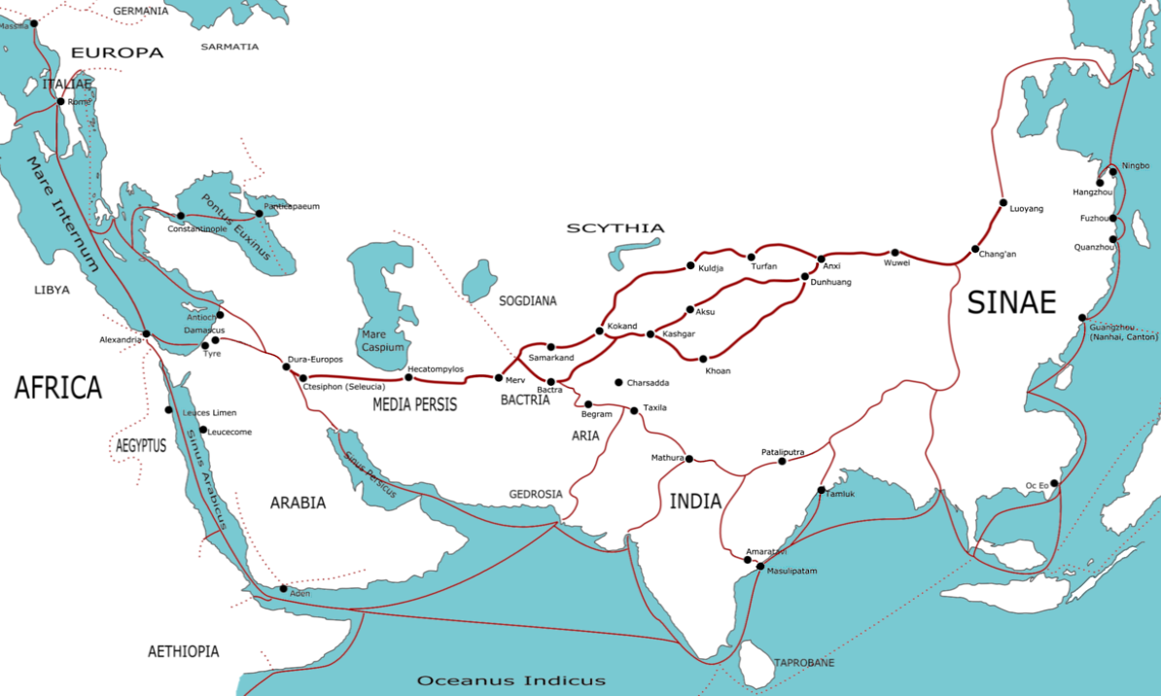
Transasia trade routes (First Century AD)
In the first century one ship was going from Egypt to India every three days

Slide 35
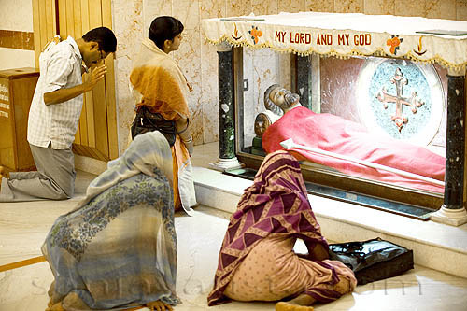

Slide 36
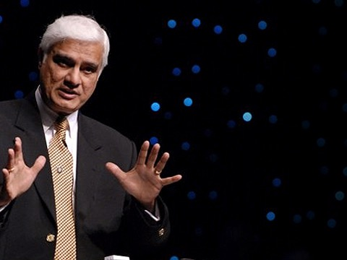
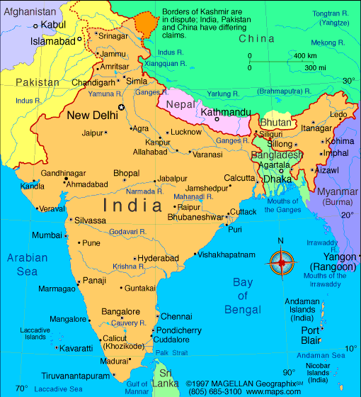

Slide 37
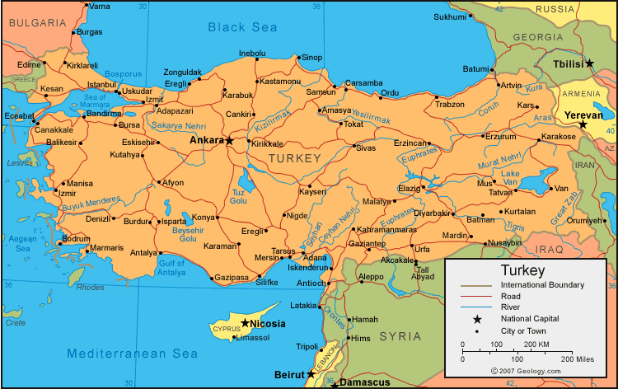

Slide 38
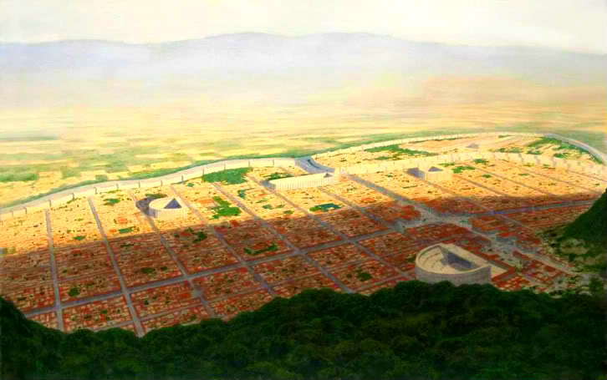
CHURCH AT ANTIOCH

Slide 39
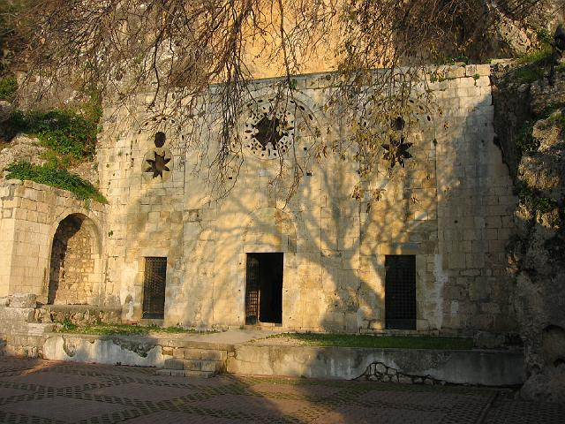
CHURCH AT ANTIOCH
The focus of western Christianity went from Antioch to Ephesus and then to Rome.

Slide 40
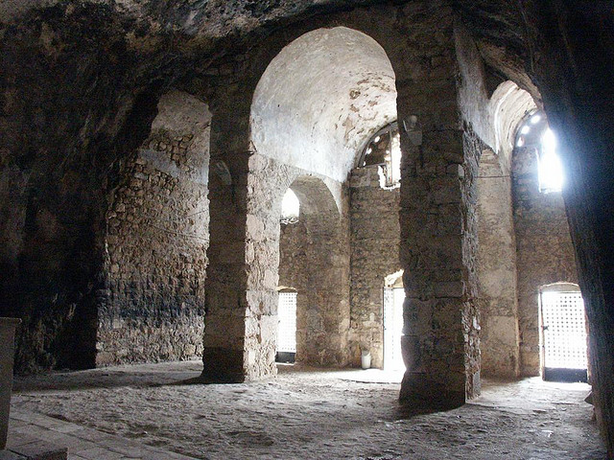
CHURCH AT ANTIOCH
The focus of western Christianity went from Antioch to Ephesus and then to Rome.
According to tradition when Jesus had a little child sit on His knee in Matthew 18 it was Ignatius who became the third bishop of Antioch.

Slide 41
CHURCH AT ANTIOCH

Slide 42
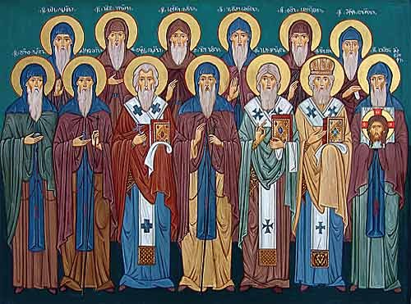
ANCIENT SYRIAN CHURCH
Chapel of St. Ananias, Damascas, Syria

Slide 44
ASIAN CHURCH HISTORY
Chapel of St. Ananias, Damascas, Syria

Slide 45
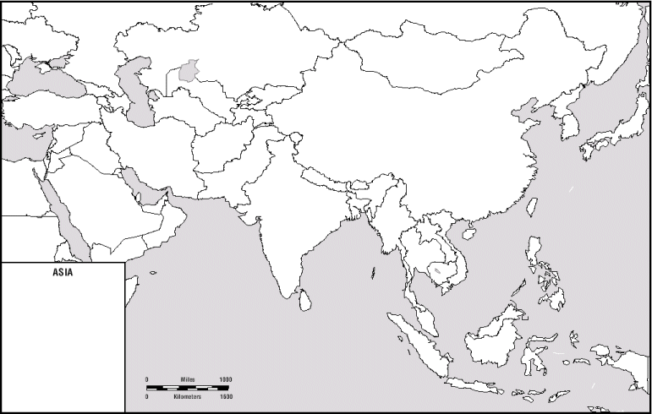
BIRTHPLACES OF WORLD RELIGIONS
All the great religions of the world
were born in Asia.
Qufu.
CHINA
.
Ur,
IRAQ
Lumbini
NEPAL
.
.
Bethlehem,
ISRAEL
.
Ayodhya
INDIA
Mecca
SAUDI ARABIA
.
BUDDHISM
CONFUCIANISM
HINDUSIM
ISLAM
JUDAISM
CHRISTIANITY

Slide 46
The Council of Nicea had 318 church leaders attend and only 8 were from the west. Most were from the east.

Slide 47
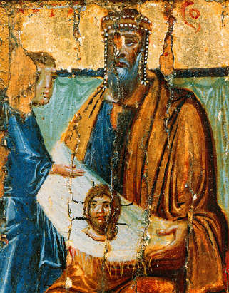
EDESSA
According to Eusebius, Abgar V, King of Edessa sent an artist to Jerusalem to paint a picture of Jesus for him.

Slide 48
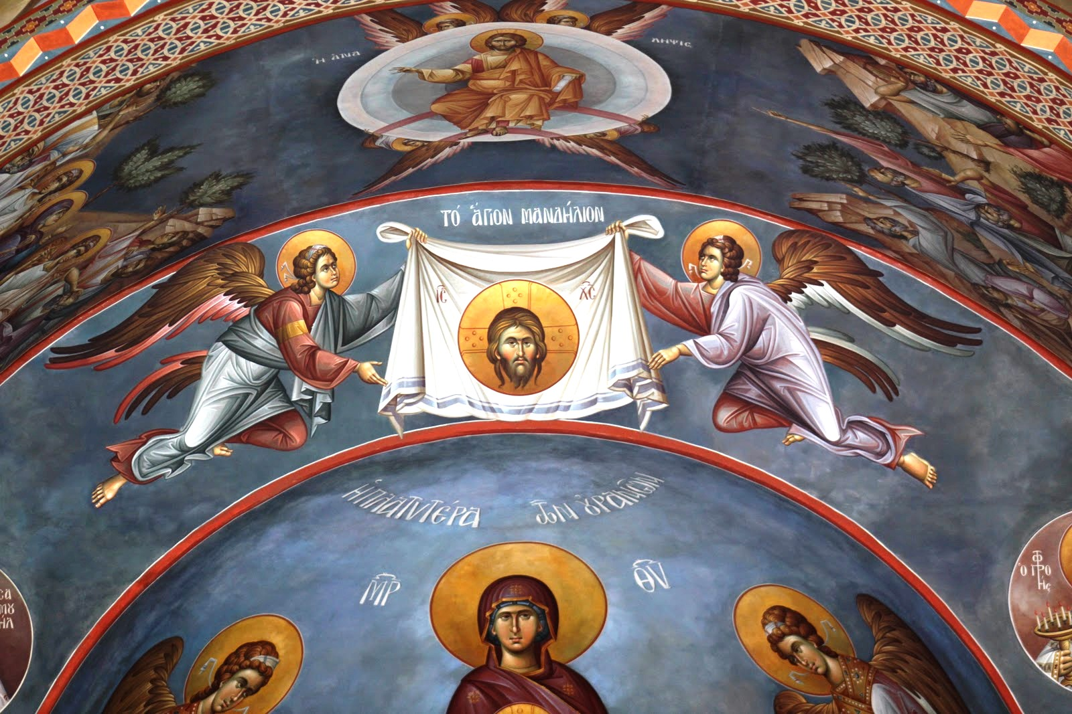
EDESSA

Slide 49
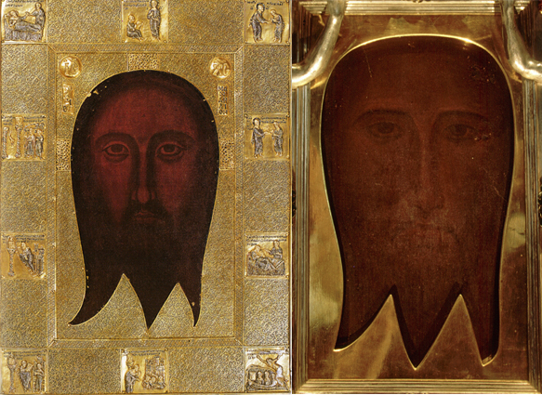
EDESSA

Slide 50
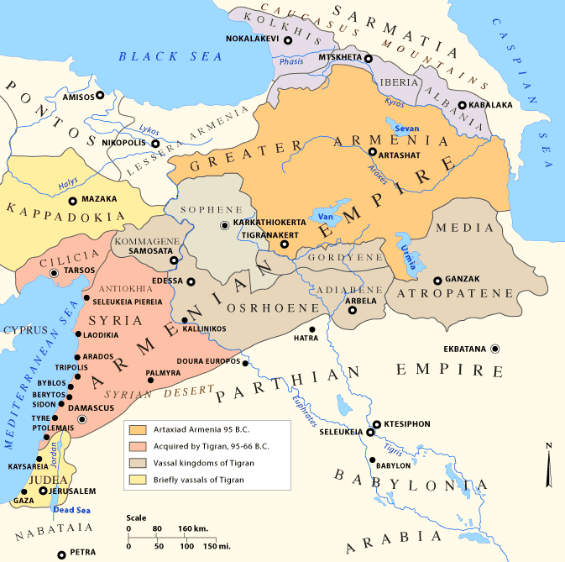
ASIAN CHURCH HISTORY

Slide 51
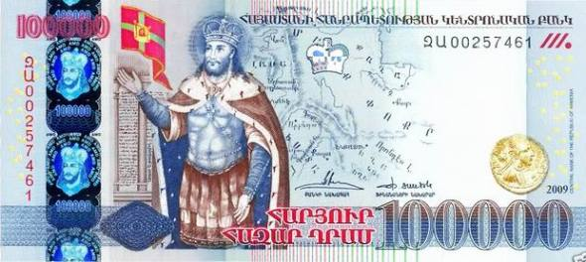
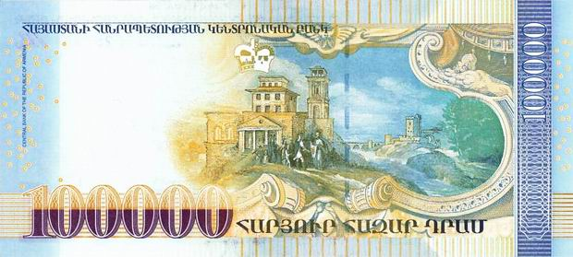
ARMENIA
Armenia is the first country to officially be called a Christian nation.

Slide 52
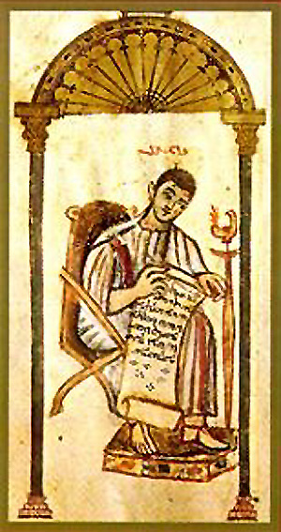
DIATESSARON - TATIAN

Slide 53
ARMENIA & IBERIA (GEORGIA)
King Miran declared that the country of Iberia (Georgia) was a Christian nation.

Slide 54
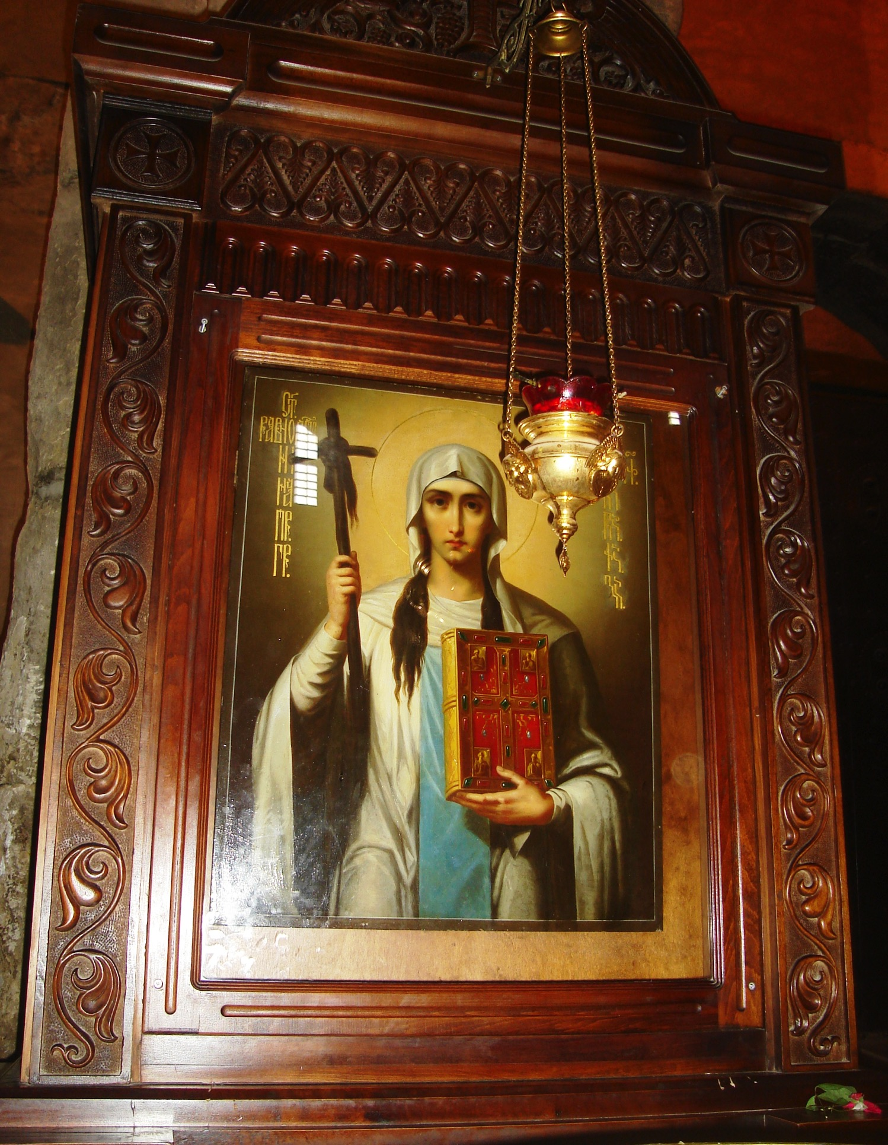
NINO

Slide 55
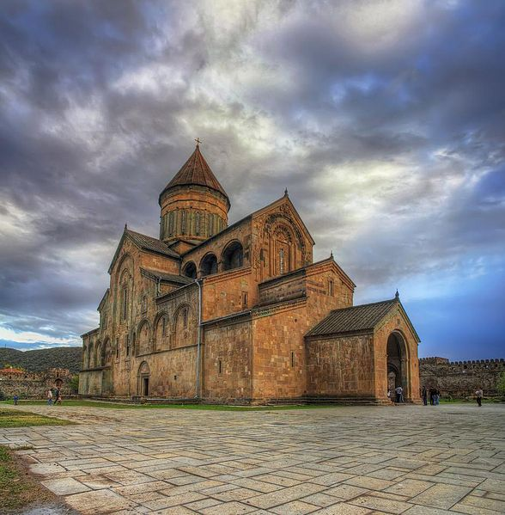
LIVING PILLAR CHURCH, MTSKHETA, GEORGIA

Slide 56
ASIAN CHURCH HISTORY

Slide 57
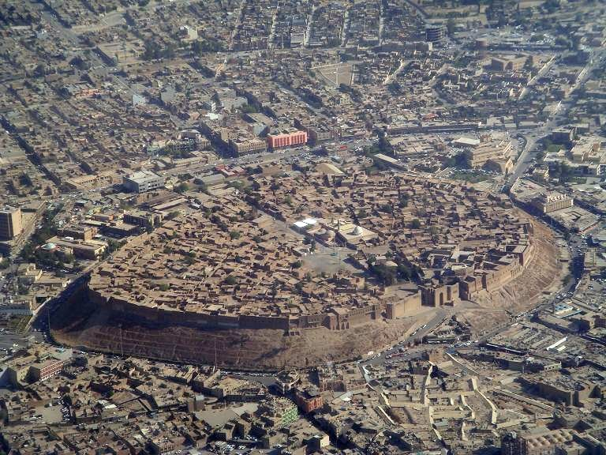
ARBELA (ERBIL, IRAQ)

Slide 58
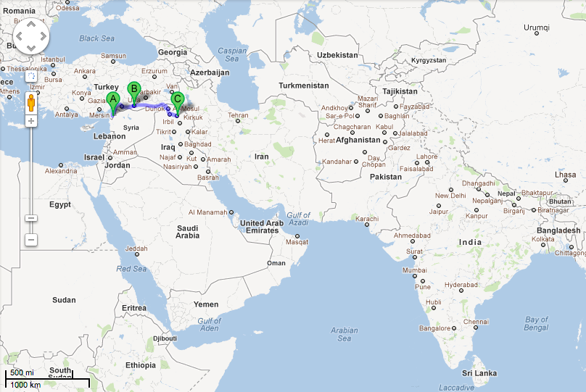
ANTIOCH – EDESSA – ARBELA
(Antakya – Urfa - Erbil)
○

Slide 59
ASIAN CHURCH HISTORY

Slide 60
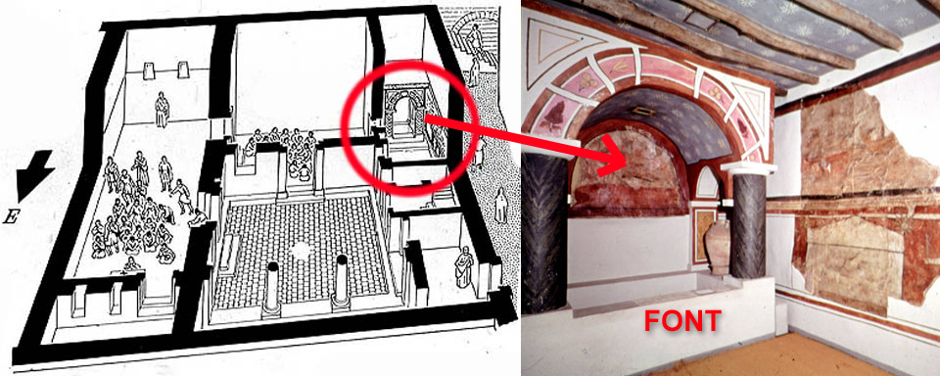
DURA-EUROPOS
The oldest Christian building dates to
AD 232 and is in Dura-Europos

Slide 61
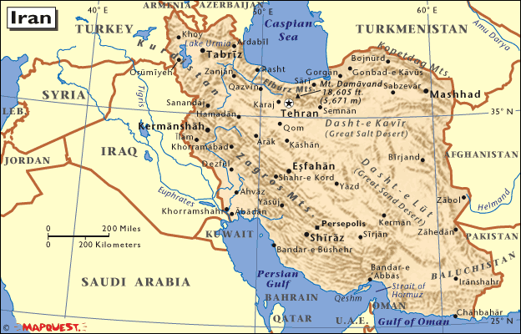
PARTHIAN EMPIRE

Slide 62
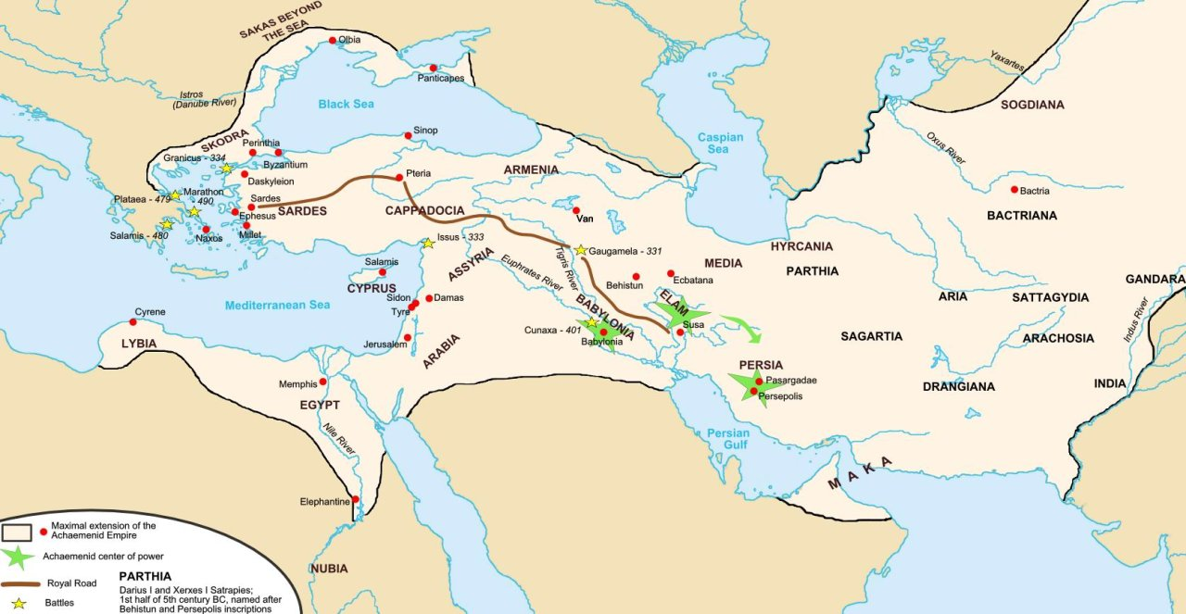
PARTHIAN EMPIRE

Slide 63
ACTS OF ST MARI
He was sent from Edessa to ‘the regions of the East’ and he became discouraged and begged the church at home to release him from his mission and allow him to return.

Slide 64
ACTS OF ST MARI
But the church ordered him to persist. So obediently but grudgingly he set himself to the evangelization of Persia.

Slide 65
ACTS OF ST MARI
So he set himself on a difficult series of missionary journeys that brought him almost to India.

Slide 66
ACTS OF ST MARI
There he said that ‘when he smelled the smell of the Apostle Thomas,” he felt at last he had done his duty and had gone far enough.’

Slide 67
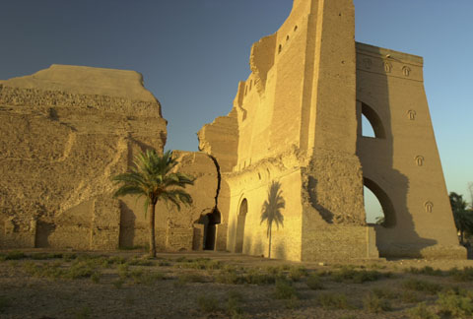
CTESIPHON
The first man known to bring structure to the Church of the East was Papa bar Aggai.

Slide 68
ASIAN CHURCH HISTORY

Slide 69
CTESIPHON
The first man known to bring structure to the Church of the East was Papa bar Aggai.
In the AD 500s, Ctesiphon was the largest city in the world.

Slide 70
ASIAN CHURCH HISTORY
NISIBIS

Slide 71
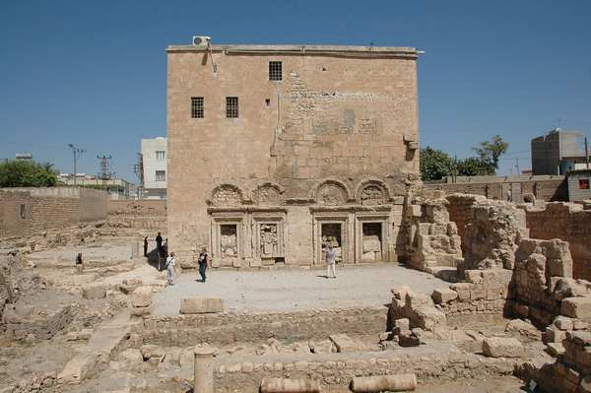
NISIBIS
Sometimes the schools of Nisibis/Edessa are called the world’s oldest university with its schools of theology, philosophy & medicine.

Slide 72
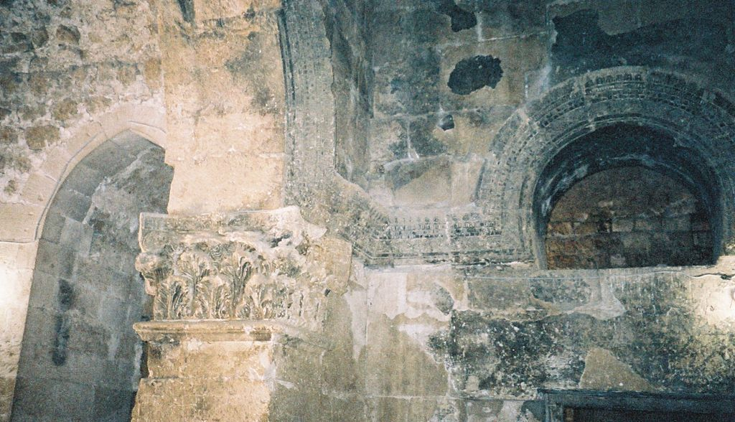
NISIBIS

Slide 73
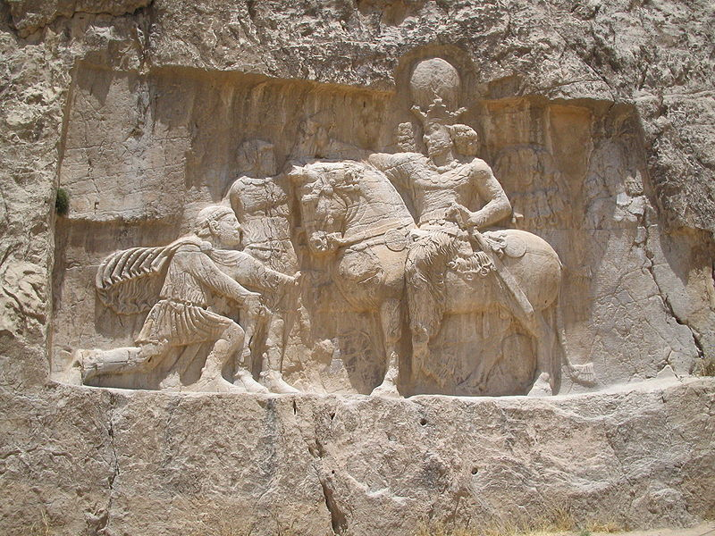
THE ROMAN-PERSIAN WARS
From the 200s BC thru the AD 600s Europe and Rome were fighting over Asia.
Shapur I triumphs over Roman Emperor Valerian, Naqsh-e Rostam, Iran.

Slide 74
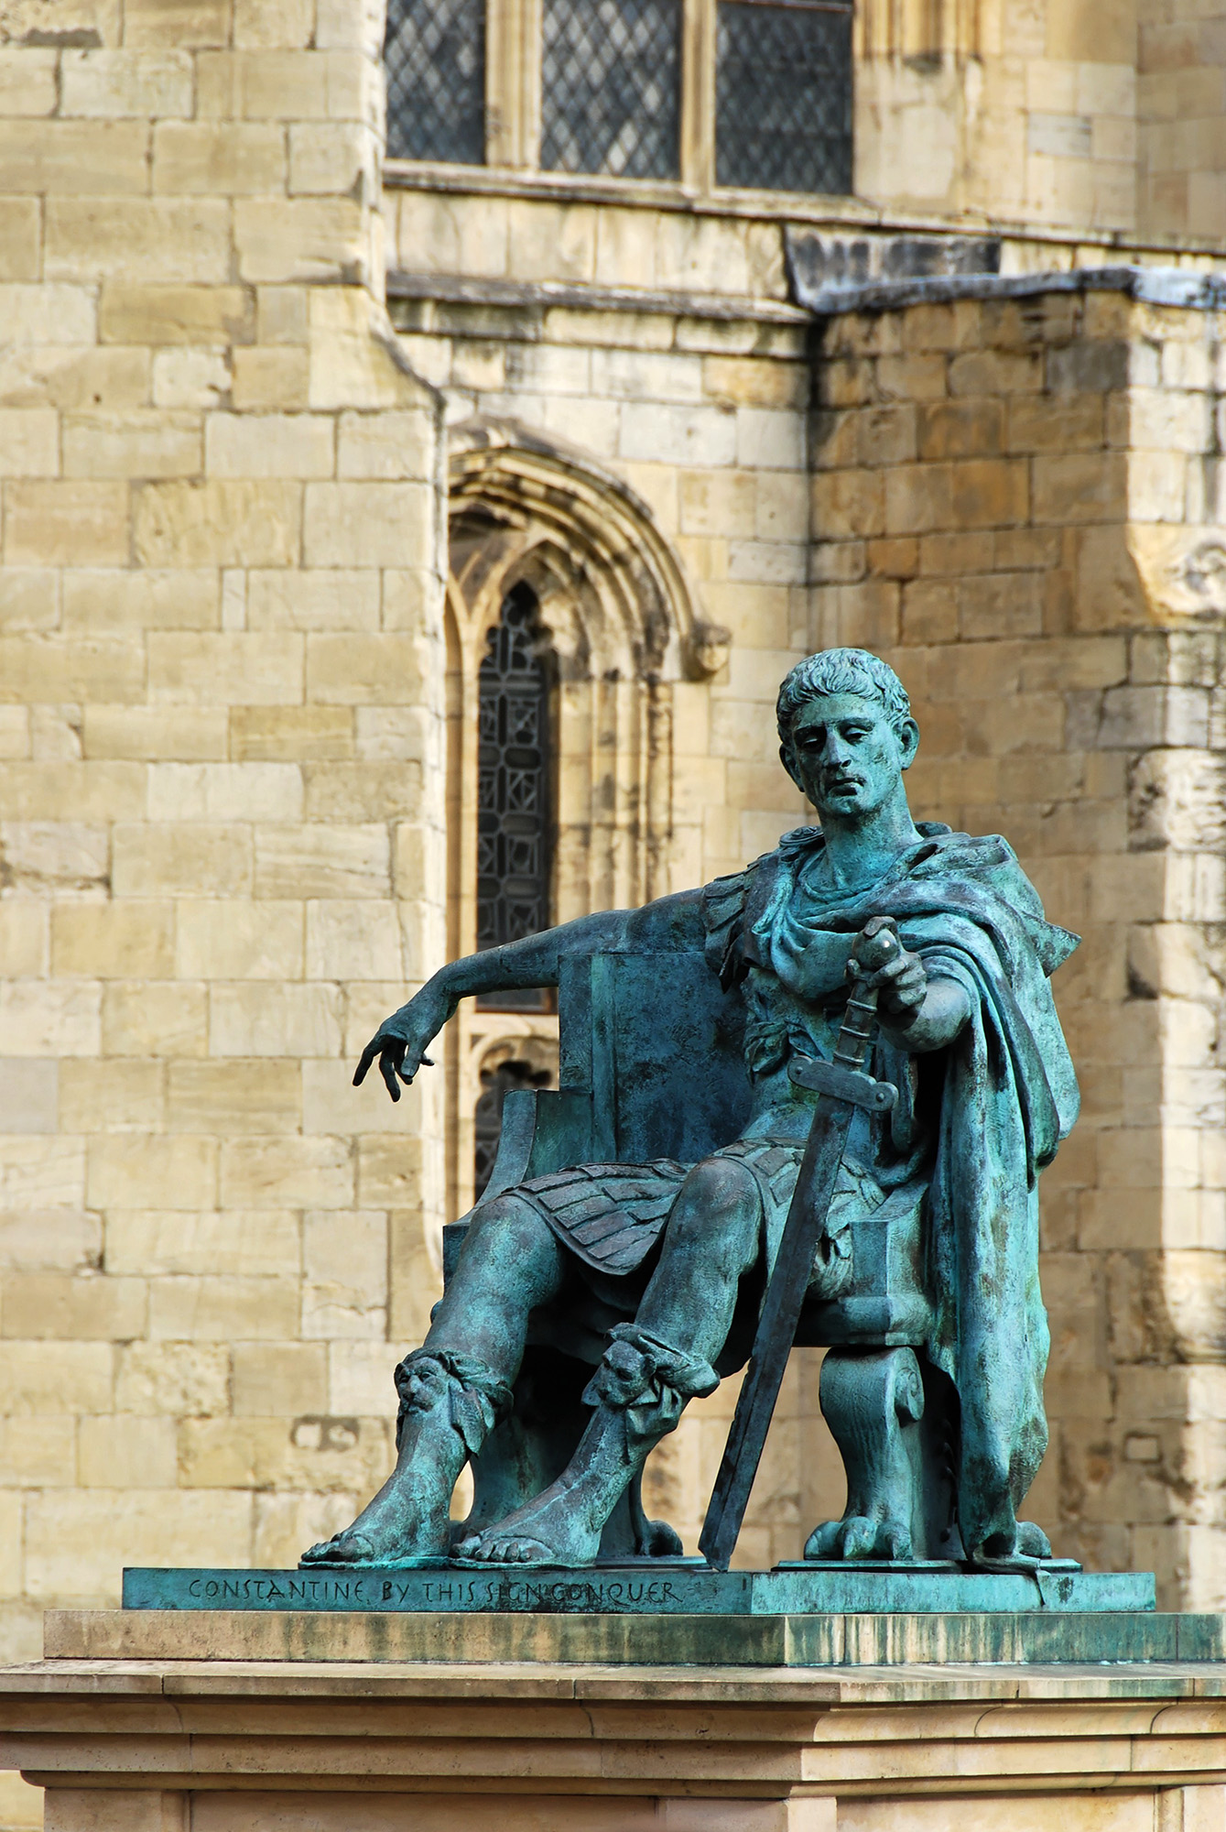
CHRISTIANITY UNDER CONSTANTINE
Constantine brought freedom to Christians in the West but because they were fighting Persia in the name of Christ the Christians in the East suffered greatly.
Constantine statute in York, England

Slide 75
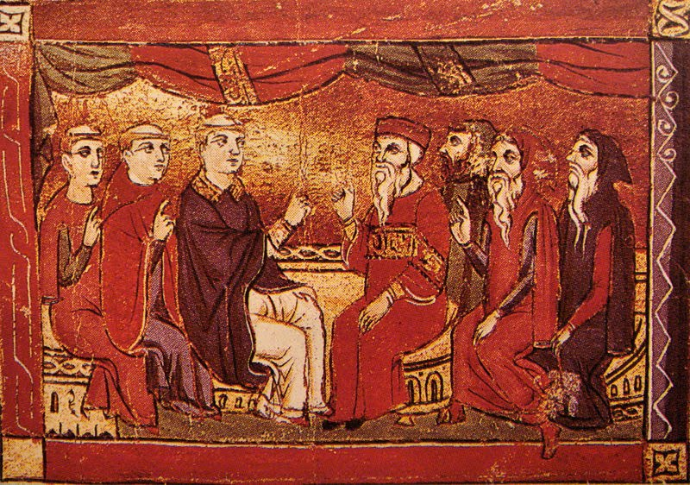
ASIAN CHURCH HISTORY
Catholics & Nestorians debating in central Asia 1290AD

Slide 76
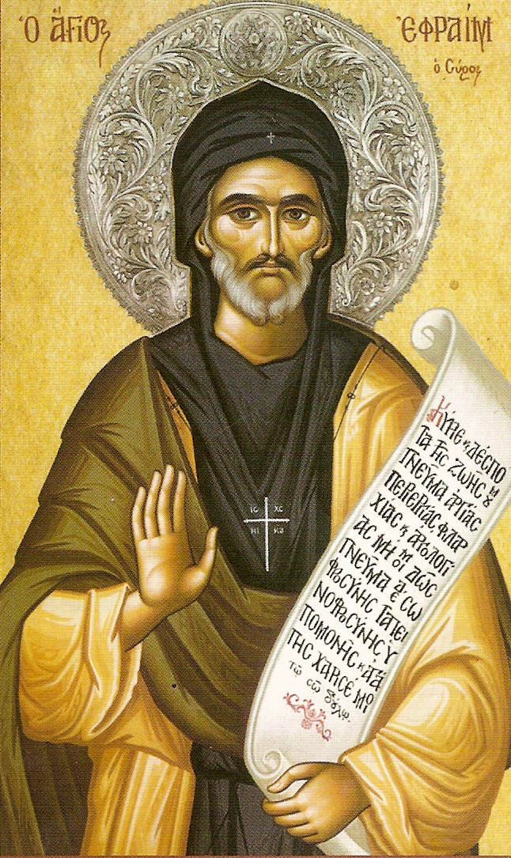
EPHREM THE SYRIAN

Slide 77
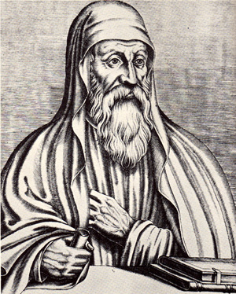
THEODORE OF MOPSUESTIA
Theodore explained Scripture in all the churches of the East

Slide 78
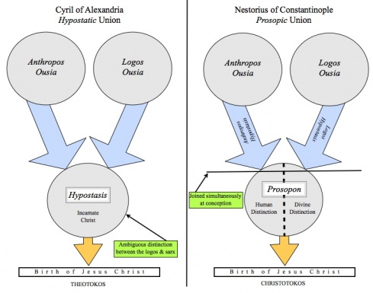

Slide 79
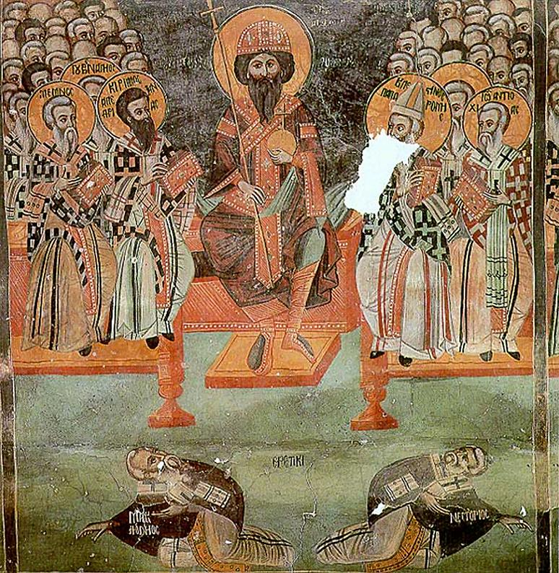
COUNCIL OF EPHESUS (431)
Nestorius became known as the heretic who believed Jesus had two natures inside of Him.

Slide 80
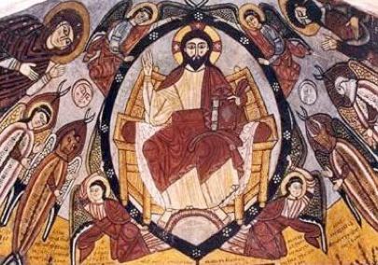
CHRISTIAN MONASTICISM
African believers - out of the world Asian believers - into the world.

Slide 81
CHRISTIAN MONASTICISM
African believers - out of the world Asian believers - into the world.
Christian monasticism began in Egypt
In 372 AD in Egypt there was almost as many monks living in the desert as there were people living in towns.

Slide 82
MAR AWGIN
The word Mar is the Syriac word for “master” or “Lord.”
The Church of the East called their leaders rabban, similar to rabbi.

Slide 83

SHAPUR II
King Shapur II asked Mar Awgin to build churches and monasteries all over Persia.
Mar Awgin sent out 70 disciples as missionaries.

Slide 84

MAR AWGIN – MOUNT IZLA

Slide 85
MAR AWGIN – MOUNT IZLA
“The graduates of these Eastern Church schools were men & women of faith, mighty in the Scriptures, fervent in prayer, gentle and humble in manner, and full of love for God and mankind. They supported themselves by the labor of their hands or subsisting on roots and fruits or on the grass of the field, it seems that they counted no trouble too great, no hardship too severe, so long as they might share in spreading abroad the message of full salvation for all mankind.”

Slide 86

CHURCH OF THE EAST (AD 500)

Slide 87

Nestorian Missionary Enterprise
The Story of a Church on Fire
JOHN STEWART
John Stewart
“a magnificent center
for the missionary church
that was entering on its great task
of carrying the gospel to the Far East.”

Slide 88
ASIAN CHURCH HISTORY

Slide 89

Christianity had become, next to Zoroastrianism, the second most powerful religious force in the [Persian] Empire.”

Slide 90
ASIAN CHURCH HISTORY
NISIBIS

Slide 91

THE SILK ROAD
The backbone of Christian growth was the Silk Road. Baghdad to Beijing was lined with Christian chapels.

Slide 92

NISHAPUR (Iran)
MERV (Turkmenistan)
HERAT (Afghanistan)

Slide 93

ANCIENT MERV
Merv was briefly the largest city in the world in the 1100s.

Slide 94

SYRIAN MISSIONARIES
“During the patriarchate of Mar Ishu Iahb II, 636, Syrian missionaries went to China, and for 150 years this mission was active … 109 Syrian missionaries have worked in China during 150 years of the Chinese mission.”

Slide 95
SYRIAN MISSIONARIES
“They went out from Beth Nahrin, the birthplace of Abraham, the father of all believers. The missionaries traveled on foot; they had sandals on their feet, and a staff in their hands, and carried a basket on their backs, and in the basket was

Slide 96
SYRIAN MISSIONARIES
the holy Writ and the cross. They took the road around the Persian Gulf; went over deep rivers and high mountains, thousands of miles. On their way they met many heathen nations and preached to them the gospel of Christ.”

Slide 97

OLD BAGHDAD

Slide 98

COSMAS
“... no limit to the number of churches, bishops and large Christian communities”

Slide 99

DIDASCALIA APOSTOLORUM

Slide 100
ASIAN CHURCH HISTORY

Slide 101

ASIAN CHURCH HISTORY
Uighar Palm Sunday service painting from Khocho, western China

Slide 102

SHAPUR II

Slide 103

5 Bishops Martyred

Slide 104

SHAPUR II
Shapur II, King of Persia

Slide 105

THE PERSIAN SUPERPOWER
Ruling over the Church of the East was the Parthian Empire (247 BC-AD 224) & then the Sassanid Empire (AD 224-651)

Slide 106

BAHRAM 5

Slide 107
PERSIAN CHRISTIANS
Differences with Roman Catholics
Roman Catholic
Persian
icons
no icons
Latin
Syriac
priests don’t marry
priests marry

Slide 108

BARTHOLOMEW

Slide 109

YEMEN & SAUDI ARABIA

Slide 110

ETHIOPIAN CHRISTIANS

Slide 111

EXPANSION IN CENTRAL & EAST ASIA
“Eastward from the great school of Edessa (Urfa) the envoys of Christianity went forth. They pitched their tent in the camps of the wandering Tartar, the Lama of Tibet trembled at their words, they stood in the rice fields of the Punjab, and they taught the fishermen by the Sea of Aral.”

Slide 112
EXPANSION IN CENTRAL & EAST ASIA
“We are called Christians by the one name of the Messiah. As regards our customs, our brethren abstain from everything that is contrary to their profession. Parthian Christians do not take 2 wives. Jewish Christians are not circumcised. Our Bactrian sisters do not practice promiscuity.

Slide 113
EXPANSION IN CENTRAL & EAST ASIA
“Persians do not take their daughter to wife. Medes do not desert their dying relatives or bury them alive. Christians in Edessa (Urfa) do not kill their wives or sisters who commit fornication, but commit them to the judgment of God. Christians in Hatra do not stone thieves.”
AD 96

Slide 114
EXPANSION IN CENTRAL & EAST ASIA
By the year AD 800 there were still more followers of Christ east of Damascus than west of Damascus.

Slide 115
ASIAN CHURCH HISTORY
Uighar Palm Sunday service painting from Khocho, western China

Slide 116

TURKISH PEOPLE

Slide 117

ALTAI MOUNTAINS

Slide 118
One reason the Persian government said they moved their capital from Ctesiphon to Baghdad in AD 762 was “because it will put us in touch with lands as far as China.”
In AD 814 Baghdad was probably
the largest city in the world.
BAGHDAD

Slide 119

EURASIA BEFORE GENGHIZ KHAN - 1200

Slide 120

WANG KHAN

Slide 121

TARBAGATAI MOUNTAINS

Slide 122

UIGURS

Slide 123

MERV
ANTIOCH
SAMARKAND
EDESSA
MERV
NISIBIS
ARBELA
NISHAPUR
XIAN
HERAT
CTESIPHON

Slide 124
ASIAN CHURCH HISTORY
NISIBIS

Slide 125

TERRA COTTA WARRIERS (XIAN)

Slide 126

TANG DYNASTY MAP (AD 750)

Slide 127

ASIAN CHURCH HISTORY

Slide 128

CHRISTIAN MONUMENT IN CHINA

Slide 129

CHRISTIAN MONUMENT IN CHINA

Slide 130
CHRISTIAN MONUMENT IN CHINA
“In the days of Father of Fathers, Mar Ananjesu, the catholicos and patriarch, when Adam, priest, was vicar, bishop and pope, i.e., Metropolitan of China in the year 1092 of the era of the Greeks (AD 781), Mar Jazedbuzid, priest and chorepiscopus of Kumdan the royal city … erected this marble tablet on which are inscribed the redemption of our Savior and the preaching of our fathers to the kings of China.

Slide 131
CHRISTIAN MONUMENT IN CHINA
Adam, deacon, son of Jazedbuzid the chorepiscopus; Mar Sergius, priest and chorepiscopus; Sabarjesu, priest; Gabriel, priest and archdeacon, church rulers of the cities of Kumdan and Sarag.”

Slide 132

CHRISTIAN MONUMENT IN CHINA

Slide 133
CHRISTIAN MONUMENT IN CHINA
The Nestorian Stele (monument) is in the Beilin Museum in Xian, China. There is a copy of it in the Vatican Museum in Rome, on the campus of George Washington University in Washington, DC, USA and at the Shingon Buddhist Temple on Koya Mountain in Japan.

Slide 134

EMPEROR HIUEN TSANG (745)
“The religion of the sacred books known as Persian had originally come from Tatsin (the Roman Empire) and that, propagated by preaching and tradition, it made its way into the Middle Kingdom and had been for a long time practiced therein.”

Slide 135

CHINA & THE WEST
“The country of Ta-ts'in is called Li-chien (Li-kin) and, as being situated on the eastern port of the sea, its territory amounts to several thousand li.. . . Their kings always
desired to send embassies to China, but the An-Shi (Parthians) wished to carry on trade with them in Chinese silks, and it is for this reason that they were cut off from communication.

Slide 136
CHINA & THE WEST
This lasted till ... (166 A.D.) when the king of Ta-ts'in, An-tun (Marcus Aurelius), sent an embassy who, from the frontier of Jih-nan (Annam) offered ivory, rhinoceros horns, and tortoise. From that time dates the direct intercourse with this country.”

Slide 137

CHRISTIAN GRAVES NEAR TOKMAK
Two ancient Christian graveyards were discovered in southern Siberia and near the city of Bishkek (modern day Kyrgyzstan) in 1885.

Slide 138

LAKE ISSYKKUL

Slide 139

KYRGYSTAN

Slide 140

MANCHURIA

Slide 141

TUN-HUANG CAVE MANUSCRIPTS

Slide 142

TUN-HUANG CAVE PAINTING
Painting of missionary bishop discovered in western China cave (1908)

Slide 143

SHOKU-NIHONGU

Slide 144

KORYUJI TAISHIDO

Slide 145

NISHI-HONGANJI
According to Teshima, the original Lecture Hall of the Koryuji Buddhist Temple erected in AD 603 was not Buddhist but Christian.

Slide 146


Slide 147

MOUNT KOYA

Slide 148

WHY CHRISTIANITY DECLINED IN ASIA
1. PERSECUTION

Slide 149

ST. CATHERINE’S MONASTERY

Slide 150

MOHAMMED

Slide 151

MOHAMMED’S PROMISE

Slide 152
MOHAMMED’S PROMISE
“This is a message from Muhammad ibn Abdullah, as a covenant to those who adopt Christianity, near and far, we are with them.
Verily I, the servants, the helpers, and my followers defend them, because Christians are my citizens; and by God! I hold out against anything that displeases them. No compulsion is to be on them.

Slide 153
MOHAMMED’S PROMISE
“Neither are their judges to be removed from their jobs nor their monks from their monasteries. No one is to destroy a house of their religion, to damage it, or to carry anything from it to the Muslims' houses.
Should anyone take any of these, he would spoil God's covenant and disobey His Prophet. Verily, they are my allies and have my secure charter against all that they hate.”

Slide 154
MOHAMMED’S PROMISE
“No one is to force them to travel or to oblige them to fight. The Muslims are to fight for them. If a female Christian is married to a Muslim, it is not to take place without her approval. She is not to be prevented from visiting her church to pray. Their churches are to be respected. They are neither to be prevented from repairing them nor the sacredness of their covenants. No one of the nation (Muslims) is to disobey the covenant till the Last Day (end of the world).”

Slide 155

WHY CHRISTIANITY DECLINED IN ASIA
1. PERSECUTION

Slide 157

ASIAN CHURCH HISTORY
Assyrian Christian Church, Erbil, Iraqi Kurdistan

Slide 158

“The metropolis of Maru Alsciahegian in Chorasania had the last metropolitan (bishop) at the end of this period … The last metropolitan (bishop) of Dailam lived in the time of the patriarch Mares II” (987-999AD) – The last metropolitan (bishop) of the province of Bardaa lived in the time of the patriarch Ebedjesu III. At the same time lived the last metropolitan (bishop) of Raia
and Tabrestania.” In AD 1073 “there was no
longer either a metropolitan (bishop) or a bishop
in the two bishoprics of Achlat (on the western
shore of Lake Arsissa) and Marga.”

Slide 159

MAHMOOD OF GHAZNI

Slide 160

WHY CHRISTIANITY DECLINED IN ASIA
1. PERSECUTION
2. DECEPTION

Slide 161

THE KRISHNA LEGEND

Slide 162

CHRIST & KRISHNA
“both called ‘Son of God’ and ‘Savior’
claim to exist on earth before birth
had human fathers who were carpenters
placed in a manger after birth
visited by shepherds and wise men
called the ‘Lion of the tribe of …’
claim to be sinless
cured lepers, cast demons, raised dead
had disciples spread their teaching
descend to hell, rise, ascend to heaven

Slide 163

WHY CHRISTIANITY DECLINED IN ASIA
1. PERSECUTION
2. DECEPTION
3. THE MONGOLS

Slide 164




FOUR GREAT KHANS
Jenghis Khan
1206-1227
Ogotai Khan
1229-1241
Guyuk Khan
1246-1248
Mongu Khan
1251-1259
Guyuk Khan was called
“a true Christian in his day.”
Mongu Khan was called “a follower
and defender of the religion of Jesus.”

Slide 165

JENGHIZ KHAN
Mongol Empire before 1259
Campaigns of Chingis Khan
Campaigns of his successors

Slide 166

JENGHIZ KHAN

Slide 167
JENGHIZ KHAN
“The greatest happiness man can have is to destroy his enemies, steal his riches, ride his horses, to see those dear to him bathed in tears, to clasp to your bosom their wives and daughters.”

Slide 168

JENGHIZ DEFEATS BEIJING

Slide 169

KARAKORUM
“My people are as numerous as the trees of the forest. I wanted them to feed on tender meat, live in beautiful tents, and pasture their horses on rich soil.”

Slide 170

THE MONGOLS DESTROY NISHAPUR
His empire was 4 times the size of Alexander the Great, twice the size of the Roman Empire, 1.5 the size of the USA

Slide 171

GENGHIS KHAN’S DNA
According to DNA testing about 16 million or one of every 200 Asian men come from Genghis Khan.

Slide 172

MONGOLS ATTACK EUROPE

Slide 173

HULAKU KHAN & WIFE DOKUZ

Slide 174

KUBLAI KHAN
Kublai Khan was the
second most famous among the Mongols.
Kublai conquered Korea by 1259.

Slide 175

JENGHIZ KHAN FAMILY TREE

Slide 176

MONGOLIAN HELMET
(Fukuoka, Japan)

Slide 177
KUBLAI KHAN
Kublai Khan was the
second most famous among the Mongols.
Kublai conquered Korea by 1259.
Kublai failed to take Japan in 1274 & 1281.
Kublai introduced ancestor worship to China.

Slide 178

GHAZAN KHAN CONVERTS TO ISLAM
The end to the Mongol Empire came because the grandsons of Genghis Khan started fighting each other.

Slide 179

MONKS OF KUBLAI KHAN

Slide 180

TRAVELS OF MARCO POLO

Slide 181

TRAVELS OF MARCO POLO
“You send me 100 men skilled in your religion and I shall be baptized and all my subjects will study Christianity too. Then there will be more Christians in the East than in the West.”
Kublai Khan 1275

Slide 183
ASIAN CHURCH HISTORY

Slide 184

WHY CHRISTIANITY DECLINED IN ASIA
1. PERSECUTION
2. DECEPTION
3. THE MONGOLS
4. TAMERLANE

Slide 185

TRANSOXANIA
Kesch.

Slide 186
TAMERLANE

Slide 187

“I was once forced to take shelter from my enemies in a ruined building where I sat for many hours. Desiring to divert my mind from my hopeless condition I fixed my attention on an ant…
TAMERLANE

Slide 188
“It was carrying a grain of corn, larger than itself, up a high wall. 69 times the grain fell to the ground, but the insect persevered on the 70th try. This sight gave me courage at the moment. I have never forgotten the lesson it gave.”
TAMERLANE

Slide 189

TAMERLANE’S EMPIRE, 1405

Slide 190

TAMERLANE’S TOMB
Under Tamerlane every church built on stone was completely leveled to the ground (700 of them).
Under Tamerlane the number of Asian Christians fell from 21 to 3.4 million.

Slide 191

MING DYNASTY

Slide 192

After 1500 years of Christianity in Asia, only two small groups were left… in India and in the mountains of Kurdistan.

Slide 193

SHIMUN FAMILY

Slide 194

MAR SHIMUN 22

Slide 195

MAR SHIMUN 23 VISITS INDIA
(1970)

Slide 196

FRANCIS XAVIER

Slide 197

ANJIRO, XAVIER & KAGOSHIMA
“I asked him whether if I went back with him to his country, the Japanese would become Christians, and he said they would not do so until they had asked me many questions and had seen by the way I answered how much I knew.”
Statues of Christians leaders in Kagoshima, Japan

Slide 198
ANJIRO, XAVIER & KAGOSHIMA
“Most of all, they would want to see if I practiced what I preached and believed… then, after watching me for 6 months, the king, the nobility, and all other people of discretion would become Christians, for the Japanese, he said, are totally guided by the law of reason.”
Statues of Christians leaders in Kagoshima, Japan

Slide 199

FRANCIS XAVIER

Slide 200

TOYOTAMI HIDEYOSHI

Slide 201

26 MARTYRS MEMORIAL
In 1597 in Nagasaki 26 Japanese Christians and foreign missionaries (including three young boys) were tied to crosses, speared and left to hang for 9 months.
Nagasaki, Japan

Slide 202

TOKUGAWA IEYASU (1543-1616)

Slide 203

TOKUGAWA HIDETADA (1579-1632)

Slide 204

TOKUGAWA IEMITSU (1604-1651)

Slide 205

1637 ARIMA FARMERS

Slide 206

COMMODORE PERRY 1853

Slide 207


URAKAMI CHURCH REBUILT

Slide 208

BERNARD PETITJEAN

Slide 209

JAPAN’S HIDDEN CHRISTIANS
In 1866 30,000 “hidden Christians” (kakure krishitan) came out and almost half joined the Catholic Church again.

Slide 210

Original sign declaring Christianity was being outlawed

Slide 211

REASONS FOR PROTESTANT GROWTH
IN JAPAN (1889)
1. EMPHASIS ON EDUCATION
2. QUALITY & ZEAL OF LEADERS
3. BIBLE TRANSLATED INTO JAPANESE

Slide 212

Fathers and seminarians in southern Japan 1881

Slide 214
ASIAN CHURCH HISTORY

Slide 215


1
2
0
0
s
MACAO
600s
1
5
0
0
s

Slide 216

MATTEO RICCI

Slide 217

MACAO

Slide 218

RICCI WORLD MAP
Kunyu Wanguo Quantu, Map of the Myriad Countries of the World, 1584

Slide 219

RICCI & XU GUANGQI
Statute at the Guangqi park in Shanghai, China

Slide 220

TRUE MEANING OF THE LORD OF HEAVEN

Slide 221

1682 MAP OF THE QING TARTARS

Slide 222

MANCHU HAIRCUT

Slide 223

RITES CONTROVERSY
Jesuits copied the Chinese and allowed them to bow and/or worship at their ancestor’s graves.
So in 1773 the pope dissolved the Jesuits.

Slide 224




THE FOUR BEIJING CHURCHES
Northern Church
1703 (1985)
Eastern Church
1655 (1904)
Western Church
1723 (1912)
Southern Church
1505 (1904)

Slide 225

“I confidently believe that on this island of Formosa there may be established that which will become… the leading Christian community… there does not exist… a more willing nation to accept the gospel.”
FORMOSA (TAIWAN) 1640 MAP

Slide 226

CHENG CHENG-KUNG
Statue of Cheng Cheng-Kung on Gulanyu, Island near Xiamen, China

Slide 227


WILLIAM CAREY:
INDIA
Notes:
The tombstone reads, “Sacred

Slide 228
Notes:
The tombstone reads, “Sacred

Slide 229

WILLIAM CAREY
William Carey is called “the Father of modern missions.”
Notes:
The tombstone reads, “Sacred

Slide 230

ADONIRAM & ANN JUDSON:
BURMA
Notes:
The tombstone reads, “Sacred

Slide 231

KAREN TRIBE
Notes:
The tombstone reads, “Sacred

Slide 232

ROBERT MORRISON:
CHINA
Notes:
The tombstone reads, “Sacred

Slide 233

MORRISON’S DICTIONARY (1822)
Notes:
The tombstone reads, “Sacred

Slide 234


ROBERT MORRISON’S GRAVE
Old Protestant Cemetery, Macau, China
Notes:
The tombstone reads, “Sacred

Slide 235

OPIUM WARS

Slide 236

SHANGHAI
NINGBO
FUZHOU
XIAMEN
GUANGZHOU

Slide 237

HUDSON TAYLOR’S FIRST CHINA TEAM

Slide 238

UNREACHED INLAND PROVINCES

Slide 239
HUDSON TAYLOR’S FIRST CHINA TEAM

Slide 240

OPEN AIR PREACHING IN CHINA:
HUDSON TAYLOR USED
THE WORDLESS BOOK

Slide 241
HUDSON TAYLOR’S FIRST CHINA TEAM

Slide 242

THE CAMBRIDGE SEVEN

Slide 243


Slide 244

100 MISSIONARIES WHO CAME IN 1888

Slide 245

CIM STATIONS 1902

Slide 246

4 CHURCH PLANTING EMPHASES:
ADAPT TO CHINESE WAYS
TRAIN CHINESE LEADERSHIP
SELECT THE BEST EVANGELISTS
LOVE THE CHINESE
TIMOTHY RICHARD

Slide 247

LOTTIE MOON

Slide 248

MT HERMON 100

Slide 249
CHINESE MARTYRS

Slide 250

1900
376,300,000 (79.7%)
60,000,000 (12.7%)
24,000,000 (5.1%)
1,670,000 (0.4%)
1,200,000 (0.2%)
436,000 (0.1%)
34,000
2000
360,000,000 (28.5%)
106,000,000 (8.4%)
19,000,000 (1.5%)
89,000,000 (7.1%)
7,000,000 (0.6%)
71,000,000 (6.0%)
FOLK RELIGIONS
BUDDHIST
MUSLIMS
CHRISTIANS
- ROMAN CATHOLIC
- PROTESTANT
- ORTHODOX
CHINA STATS

Slide 252

ASIAN CHURCH HISTORY
1835 Japanese map based on old French document

Slide 253

HENDRICK HAMEL’S SHIPWRECK

Slide 254

HENDRICK HAMEL’S SHIPWRECK
Hendrick Hamel was the first westerner to write about Korea with firsthand knowledge.

Slide 255

CHARLES GUTZLAFF

Slide 256

QUELPORT (JEJU ISLAND)
“The most southern Quelport is a charming spot. It is well cultivated, and so conveniently situated, that if a factory was established here we might trade with the greatest of ease to Japan, Korea, manchuria and China. But if this is not done, could not such an island become a missionary station?”

Slide 257
ROBERT THOMAS

Slide 258

ATTACK ON GENERAL SHERMAN

Slide 259

GENERAL SHERMAN MONUMENT IN N.K.
Robert Thomas was
the first Protestant foreign missionary martyr to Korea.

Slide 260

JOHN ROSS
John Ross translated
the first complete copy of
the Korean New Testament.

Slide 261

DR. HORACE ALLEN
Dr. Horace Allen
saved Prince Min’s life

Slide 262

KOREA’S FIRST MEDICAL CENTER

Slide 263

HENRY APPENZELLER

Slide 264

BAEKJAE SCHOOL

Slide 265

HORACE UNDERWOOD

Slide 266

15 YEARS AMONG THE TOP-KNOTS

Slide 267

JOHN NEVIUS
John Nevius not only emphasized evangelism and Bible study but taught the 3-self principles of church growth:
self propagating,
self governing &
self-supporting.

Slide 268


Slide 269

1907 PYONGYANG REVIVAL EVANGELISTS
The Pyongyang revival included sincere prayer, a desire to be close to God, confession of sin with a humble mind & being others-centered.
First Graduating Class, Pyongyang Seminary (1907)

Slide 270

Yi Gi-Pung was Korea’s first missionary. He went to Jeju Island.

Slide 271

KOREAN MISSION TEAM - AFGHANISTAN
“Dying for Christ is a glorious thing. Don’t cry for me if I die in service to my Lord. Put on my tombstone, “He died training young people to make a difference in the world.”

Slide 272
5 GENERALIZATIONS ABOUT ASIAN CHURCH HISTORY IN THE 1800s
1. A TIME OF CHURCH GROWTH
2. A TIME OF PROTESTANT MISSIONS
3. A TIME OF EVANGELISM
4. A TIME OF WOMEN IN MISSION
5. A TIME OF VOLUNTEERS
1835 Japanese map based on old French document

Slide 273
1. THE SYRIAN TRADITION (50-225)
2. THE OLD SILK ROAD (225-1000)
3. TO THE EAST (1000-1350)
4. THE CATHOLIC WAVE (1500-1750)
5. THE PROTESTANT WAVE (1750-1900)
ASIAN CHURCH HISTORY

Slide 275

ASIAN CHURCH HISTORY
Services at the Shouwang (Underground) Church in Beijing

Slide 276


CHURCH PLANTING MOVEMENTS

Slide 277

CHURCH PLANTING MOVEMENTS

Slide 278
CHURCH PLANTING MOVEMENTS
“But whatever house you enter, first say, ‘Peace to this house.’ ⁶ And if a son of peace is there, your peace will rest on it; if not, it will return to you. ⁷ And remain in the same house … Do not go from house to house.⁸ Whatever city you enter, and they receive you, eat such things as are set before you. ⁹ And heal the sick there, and say to them, ‘The kingdom of God has come near to you.”
Luke 10:5-9

Slide 279
BIRTHPLACES OF WORLD RELIGIONS
All the great religions of the world
were born in Asia.
Qufu.
CHINA
.
Ur,
IRAQ
Lumbini
NEPAL
.
.
Bethlehem,
ISRAEL
.
Ayodhya
INDIA
Mecca
SAUDI ARABIA
.
BUDDHISM
CONFUCIANISM
HINDUSIM
ISLAM
JUDAISM
CHRISTIANITY

Slide 280


Slide 281

Reach the campus today … reach the world tomorrow

Slide 282

REACHING LEADERS FOR CHRIST

Slide 283


Slide 284

ASIAN CHURCH HISTORY TIMELINE
COUNCIL OF SELEUCIA/
CTESIPHON (410)
THE PROTESTANT REFORMATION (1517)
PROTESTANT
THE GREAT SCHISM (1054)
ROMAN CATHOLIC
COUNCIL OF NICEA (325)
EASTERN ORTHODOX
COUNCIL OF EPHESUS (431)
CHURCH OF THE EAST
SYRIAN TRADITION
OLD SILK ROAD
TO THE EAST
CATHOLIC WAVE
PROTESTANT WAVE
50
225
1000
1350/1500
1750
1900
JESUS’ RESURRECTION (33)
NESTORIAN MONUMENT (635)
XAVIER IN JAPAN (1549)
CHURCH AT ANTIOCH (37)
NESTORIAN DOCTOR IN JAPAN (736)
RICCI IN CHINA (1582)
THOMAS TO INDIA (52)
TIMOTHY I (780-823)
JAPAN’S ANTI-CHRISTIAN
EDICT (1614, 1868)
ADDAI TO EDESSA (120)
CHINA’S ANTI-CHRISTIAN EDICT (845)
CHRISTIAN ARMENIA (301)
JENGHIZ KHAN (1167-1227)
DUTCH IN TAIWAN (1642-77)
CHRISTIAN GEORGIA (326)
CAREY IN INDIA (1793)
MARCO POLO TO CHINA (1275)
JUDSONS IN BURMA (1812)
SCHOOL OF EDESSA/NISIBIS (350)
TAYLOR IN BURMA (1866)
MUHAMMED (570-632)
TAMERLANE (1336-1405)
PYONGYANG REVIVAL (1907)
PARTHIAN EMPIRE
SASSANID EMPIRE
ISLAMIC RULE
MONGOL EMPIRE
MING DYNASTY
MANCHU DYNASTY
224
651
1206
1370
1644
1912
0 100 200 300 400 500 600 700 800 900 1000 1100 1200 1300 1400 1500 1600 1700 1800 1900 2000

Slide 285
ASIAN CHURCH MAP
NAIMANS
KERAITS (1007)
KARAKORUM (1246)
UIGHARS
EDESSA (120)
SAMARKAND (400s)
NISHAPUR
MERV (553)
ARBELA
XIAN (635)
ANTIOCH (37)
HERAT (585)
CTESIPHON+ (410)
MACAO
BAGHDAD+ (781)
INDIA (52)

Slide 286
Black

Slide 287


Asian Church History link at BibleStudyDownloads.org
Download this presentation for free!
Notes:
The Bible…Basically (bb)

